Slide 1
Incorporation of metacognition and mindfulness instruction into majors and non-majors chemistry courses
Doug Schirch, Ph.D.
Professor of Chemistry

Slide 2
Please read this handout before the presentation:

Slide 3
The Problem with the Chainsaw
A person goes to a hardware store looking for a saw to cut trees. The dealer sells them a chainsaw. “You can cut many dozens of trees daily with this!”
The customer takes the chainsaw home, works several hours, only cuts up 2 trees, and decides, "I should work harder." The next morning the person starts at 5 a.m. and cuts and cuts till nightfall, but only manages to cut up 5 trees.
The customer returns to the store to complain. Other customers say their saws are working beautifully, easily cutting dozens of trees daily. The dealer says the customer may need to sharpen the saw. The customer sharpens the chainsaw and then does a grueling 24-hour cutting marathon, but only gets 12 trees cut up.
The customer takes the chainsaw back to the dealer and laments: “My saw doesn’t work as good as saws other people got.”
The dealer, baffled, removes the chainsaw from the case and pulls the cord to start it: BRMM-BRMM-BRMM-BRMM.
The customer’s eyes get huge. "What's that noise!!??”

Slide 4
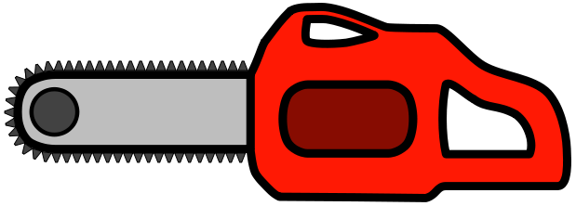
The chainsaw is a metaphor for your brain. Think that maybe your brain can’t do chemistry problems? I think you’re not using it right. I want you to learn how well your chainsaw can work. In this course I teach chemistry, and I teach metacognition.

Slide 5
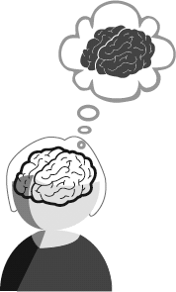
What is Metacognition?
Thinking about your thinking.
Analyzing your learning
For answering certain questions/problems, the ability to reflect on your mental processes and use appropriate strategies.
Ability to know when answers are right or wrong.
Or,
Thinking about using your chainsaw
http://www.ascd.org/publications/books/117002/chapters/Introduction-to-Metacognition.aspx

Slide 6
Why teach metacognition?
Would it help first-generation students?
Chem 103 and 303, 2021-22
First-generation? | Top 80% of class | Bottom 20% of class | Totals
Yes | 15 | 10 | 25
No | 28 | 1 | 29
Totals: | 43 (79.6%) | 11 (20.4%) | 54
X² (1, N = 54) = 11.1, p = 0.00088
Cramer’s V = 0.45 (medium-large effect size)

Slide 7
Insights from Repeat Students
who either got same grade in 2nd (and 3rd attempt)
or do markedly better
Key difference in 2nd attempts:
“I studied differently, like how you told us the first day.”

Slide 8
Outline
Initial approach to teaching metacognition in my courses
Feedback/results
Revised approach including focus/mindfulness

Slide 9
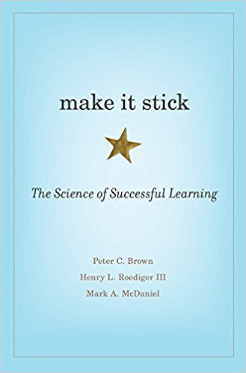
Inspiration #1
1. Many students have poor metacognition.
2. They rely on study practices that give a false illusion of working.
Cognitive psychologists.

Slide 10
Make It Stick: Experiment on memorization
Vary: how much time students spend studying vs. testing.
Group SSSS | Group SSST | Group STTT
All students spend 7 minutes reading the same 250-word passage
Study the passage | Study the passage | Study the passage
Study the passage | Study the passage | Do a recall test
Study the passage | Study the passage | Do a recall test
Study the passage | Do a recall test | Do a recall test
After 1 week all students take same test on how much they remembered.
Psychol Sci. 2006 Mar;17(3):249-55.
Students polled in assigned video: which group did better?

Slide 11
Make It Stick: Experiment on memorization
Vary: how much time students spend studying vs. testing.
Group SSSS | Group SSST | Group STTT
All students spend 7 minutes reading the same 250-word passage
Study the passage | Study the passage | Study the passage
Study the passage | Study the passage | Do a recall test
Study the passage | Study the passage | Do a recall test
Study the passage | Do a recall test | Do a recall test
After 1 week all students take same test on how much they remembered.
The material looks increasingly familiar, creating an illusion of “knowing”.
The tests highlight errors, not knowing.
Psychol Sci. 2006 Mar;17(3):249-55.

Slide 12
Massed vs. Spaced Practice
Other examples from Make It Stick

Slide 13
Medical School Experiment
19 Surgical residents | 19 Surgical residents
All 38 students: same 4 short lessons in microsurgery: reattaching blood vessels. Instruction + practice.
1 week between each lesson. | All lessons in same day.
1 month later: exam
Poll: Which group do you think performed better on the exam?

Slide 14
Medical School Experiment
19 Surgical residents | 19 Surgical residents
All 38 students: same 4 short lessons in microsurgery: reattaching blood vessels. Instruction + practice.
1 week between each lesson. | All lessons in same day.
1 month later: exam
Outperformed other group.
Between lessons: normal forgetting
Difficult later recall forms long-term memory

Slide 15
Grouped vs Interleaved Practice

Slide 16
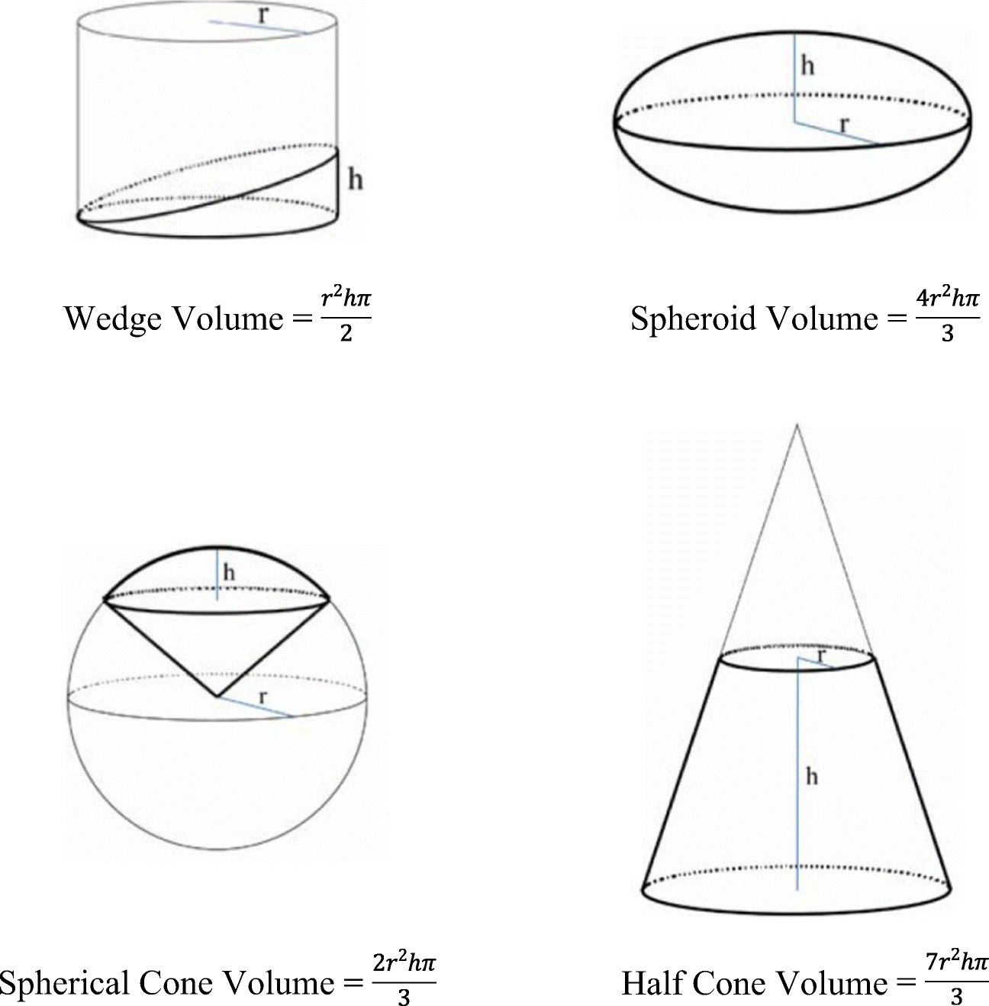
Comparison – Practice Calculating Volumes of: Wedges, Spheroids, Spherical Cone, Half Cone
https://link.springer.com/article/10.3758/s13421-019-00918-4

Slide 17
Comparison – Practice Calculating Volumes of: Wedges, Spheroids, Spherical Cone, Half Cone
 | Grouped Practice | Interleaved Practice
Practice | 4 problems with wedges, 4 problems with spheroids, etc. | Same problems, but sequence was mixed
D. Rohrer & K. Taylor, The shuffling of mathematics problems improves learning, Instructional Science 35 (2007), 481-498

Slide 18
Comparison – Practice Calculating Volumes of: Wedges, Spheroids, Spherical Cone, Half Cone
 | Grouped Practice | Interleaved Practice
Practice | 4 problems with wedges, 4 problems with spheroids, etc. | Same problems, but sequence was mixed
Score During Practice | 89% correct | 60% correct
Test 1 Week Later

Slide 19
Comparison – Practice Calculating Volumes of: Wedges, Spheroids, Spherical Cone, Half Cone
 | Grouped Practice | Interleaved Practice
Practice | 4 problems with wedges, 4 problems with spheroids, etc. | Same problems, but sequence was mixed
Score During Practice | 89% correct | 60% correct
Test 1 Week Later | 20% correct | 63% correct
Fooled
My 1st-generation students miss these questions at about twice the rate of non-first generation students

Slide 20
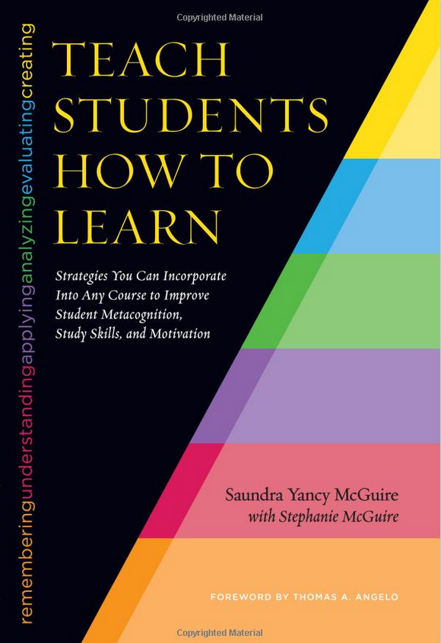
Inspiration #2
Strategies you can incorporate into any course to improve student metacognition, study skills, and motivation.
Developed 50-min. lecture
Gave in G. Chem. classes
Best: after 1st major exam.
Demonstrated positive outcomes.
[Keynote speaker, 2019 AAC&U STEM, Chicago]
https://faculty.lsu.edu/smcgui1/

Slide 21
What was done in 2 courses

Slide 22
Modifications to course metacognitive instruction Acc. to Make It Stick principles:
Spaced:
Instead of ‘one and done,’ all semester long
Weekly short lessons as screencast videos (~ 6 min.)
Assigned for weekends
Interleaved
Testing
Start of each Monday class: 2-min. quiz on video content

Slide 23
Expected student reactions
“Yet more content in Org. Chem?!”
“It’s not even Org. Chem?!”
“More quizzes in Org. Chem?!”
‘A’ students: won’t benefit
Others: only some recommendations needed
My hope: at least half of students appreciate.
If not, still continue if perceived to help at-risk students

Slide 24
Topics of metacognition videos
Topics from
Make It Stick
Teach Students How to Learn
How to solve recent class problems.
Incl. intro to Bloom’s Taxonomy of Learning
2 videos from [https://guides.fscj.edu/BOSS/TimeManagement ]
[Presenters, 2019 AAC&U STEM, Chicago]

Slide 25
Pop Quiz! Get out a pencil/pen

Slide 26
Part 1
When I say, “Start,” you have 10 seconds to write as many sequential numbers as you can, starting with 1.
1 2 3 …..

Slide 27
Part 2
When I say, “Start,” you have 10 seconds to write as many sequential letters as you can, starting with A.
A B C …..

Slide 28
Part 3
Turn the page to the other side.
When I say, “Start,” you will have 20 seconds to write as many sequential number-letter combinations as you can.
1A 2B 3C ….. [No going back]

Slide 29
Results
You had the same amount of time as the previous 2 tests combined. How many got to the same number and letter as the previous tests?
What your brain was doing?
Multitasking.
It is not wired to multitask.
This was easier than organic chemistry and not new knowledge.

Slide 30
Effects of Multitasking
Less efficient.
Requires more energy; quicker exhaustion.
More stressful.
Less successful storage of new information in the hippocampus:
the area of the brain where information is organized and categorized, necessary for later retrieval.

Slide 31
Class Organization
 | Before class | In class | After class
Traditional |  | Lecture | Homework practice

Slide 32
Class Organization
 | Before class | In class | After class
Traditional |  | Lecture | Homework practice
My courses (flipped) | Lecture videos | Homework practice in small groups

Slide 33
Class Organization
 | Before class | In class | After class
Traditional |  | Lecture | Homework practice
My courses (flipped) | Lecture videos | Homework practice in small groups
Increasing numbers of students with little or no idea of what was in lecture videos.

Slide 34
Student responses to end-of-course surveys [IRB approved]

Slide 35
Repeat next year?

Slide 36
Did they see positive outcomes?

Slide 37
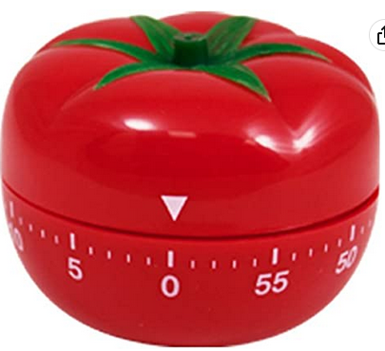
Did they change study habits? Which ones?
Open-ended survey question:
Compared to the start of the course, describe any ways that you now study differently.
 | Org 1 (n=40) | (G)OB (n=55)
Reduced multi-tasking and/or adopted Pomodoro technique | 48 % (19) | 36% (20)
Other changes | 50 % (20) | 53% (29)
No change mentioned | 3% (1) | 11% (6)

Slide 38
Finish course with growth mindset?

Slide 39
‘Ah Ha’ moment
Study: Frequency that undergrads on computers switch screens:
Yeykelis L, Cummings JJ, Reeves B. 2014. J Commun. 64(1):167–192
Average = 65 sec.
Median = 19 sec.
Spring 2023:
Surveyed students regarding their focus
Made 2 new videos on topic

Slide 40
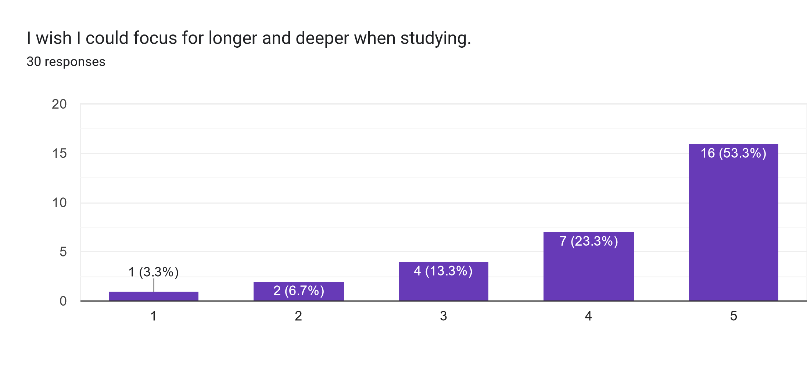
Survey of Chem 103 Students
Strongly
disagree
Strongly
agree
This slide and some following shown to students in new videos

Slide 41
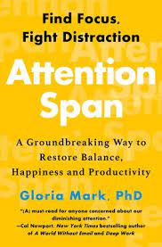
Social media
Smart phones
PC
email
www
1980
1990
2000
2010
2020
10-30 min.??
(2004)
2:30 min.
“Unfathomable.”
(2012)
1:15 min.
(2021)
0:45 min.
When working on a computer, how long before people switch to another activity?

Slide 42
Research into how interruptions happen
Uninterrupted focus
External interruptions
External interruptions removed
Text chime
Person asks question
Email chime
FB notification
Text chime
Negative thoughts
Check phone
Start conversation
Avoid something not enjoying
Negative thoughts
Internal interruptions.
Mind conditioned.
I remember this!

Slide 43
“The Gen Z brain has been rewired
for a diminished ability to focus and concentrate.”
https://www.facultyfocus.com/articles/effective-teaching-strategies/the-mindful-learning-framework/?st=FFdaily%3Bsc%3DFF230206%3Butm_term%3DFF230206&mailingID=4444

Slide 44
Strategies for Increasing Focus
Step 1: Practice meta-awareness:
Be aware of your awareness
Switching attention back and forth ?
Multitasking?
Locked in an addictive pattern?

Slide 45
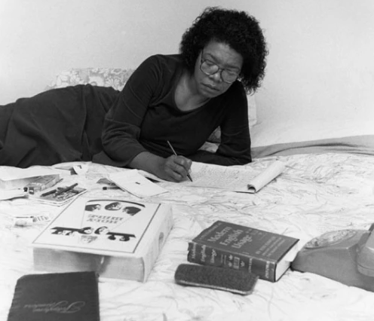
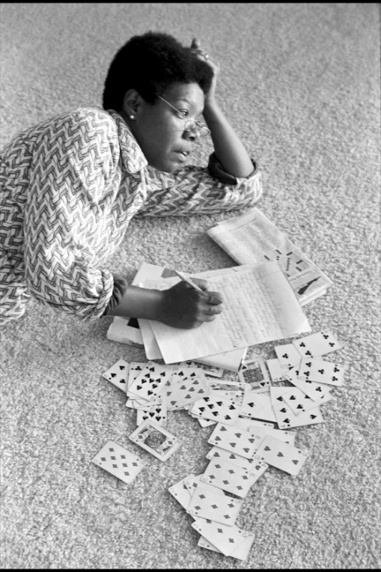
Recommendation: Work like Maya Angelou I Know Why the Caged Bird Sings
How she wrote.
Hotel room
6:30 a.m.
Removed wall paintings
Brought cards and crossword puzzles.
Said she alternated between using her
‘big mind’ for deep thoughts,
and ‘small mind’ for crosswords and cards.
https://awritersden.wordpress.com
www.msnbc.com/msnbc/maya-angelou-radical-activist-msna338781
https://asialenae.com

Slide 46
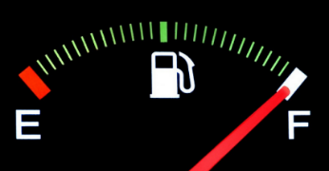
Recommendation: Work like Maya Angelou I Know Why the Caged Bird Sings
How she wrote.
Hotel room
6:30 a.m.
Removed wall paintings
Brought cards and crossword puzzles.
Said she alternated between using her
‘big mind’ for deep thoughts,
and ‘small mind’ for crosswords and cards.
Place
Time. Follow your natural rhythm of awareness
Remove distractions
www.msnbc.com/msnbc/maya-angelou-radical-activist-msna338781
Activities that replenish our attention tank:
-Rote activities (not challenging)
-Boredom

Slide 47
“Digital Detox”
At certain times
At certain places
By changes on your phone
Social media, email, etc.:
rather than many short interruptions all day,
do at set, limited times,
but not during optimal focus times.

Slide 48
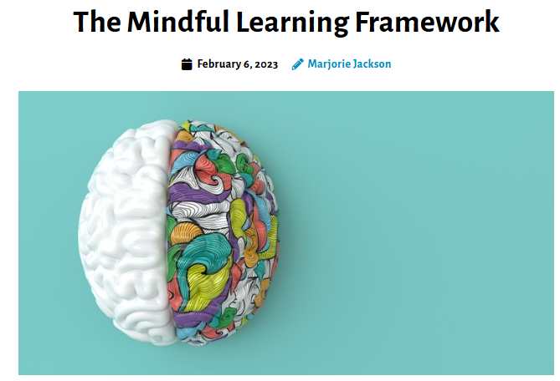
www.facultyfocus.com

Slide 49
thenovicechefblog.com/easy-instant-pot-cheesecake
buzzitt.com
twitter.com/CDCgov

Slide 51
Recognition
Goshen College Faculty Development Mininger Grant
Goshen College Psychology faculty
Julie Reese
Amanda Sensenig
Michelle Blank, Academic Success Director
Questions?
dougms@goshen.edu

