Slide 1
Math 170 Functions, Data, and Models
18 Exponential Graphs & Data
Section 4.3

Slide 2
Basic Concepts
A function is linear if it changes at a constant absolute rate.
$y=b+m x$
$b$ is the initial value; $m$ is the rate of change
A function is exponential if it changes at a constant percentage rate.
$y=a b^{x}$
$y=a {(1+r)}^{x}$
$a$ is the initial value; $b>1$ is the growth factor; $r>−1$ is the growth rate

Slide 3
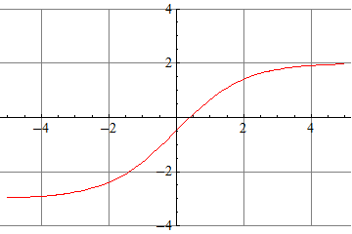
Limit Examples
Suppose $g$ is defined by the complete graph (all important features are shown). Find $g(1)$ and solve $g\left(x\right)=−2$.
Find $\lim_{x→∞}{g(x)}$ and $\lim_{x→−∞}{g(x)}$.
Suppose $f\left(x\right)=3−2{(1.03)}^{x}$. Find f$(1)$ and solve f$\left(x\right)=1$.
Find $\lim_{x→∞}{f(x)}$ and $\lim_{x→−∞}{f(x)}$.
Will $h\left(x\right)=5{(1.3)}^{x}$ and $k\left(x\right)=3{(1.2)}^{x}$ cross?

Slide 4
Houston Population (4.3 end)
 | 0 | 10 | 20 | 30 | 40 | 50 | 60 | 70 | 80 | 90 | 100 | 110
 | 184 | 236 | 332 | 528 | 737 | 1070 | 1583 | 2183 | 3122 | 3733 | 4672 | 5937
The data in the table gives population N in thousands for the Houston Metro Area t years since 1900.
Find a best fit linear equation to the data. Interpret.
Find a best fit quadratic equation to the data. Interpret.
Find a best fit exponential equation to the data. Interpret.
Compare the three models (and the one suggested by the book $P=190{(1.034)}^{t}$) in terms of error and parameter count.

