Slide 1
Math 170 Functions, Data, and Models
12-13 Quadratic Functions
Sections 3.1-2
Questions on Lab03?

Slide 2
Basic Concepts
Multiplication, distributive law, and FOIL from a geometric perspective.
Factoring (e.g. $3x^{2}+5x−2$ & $x^{2}−6x+9$)
Quadratic function
$y=ax^{2}+bx+c$ standard form
$y=a(x−r)(x−s)$ factored form
$y=a{(x−h)}^{2} + k$ vertex form parabola graph

Slide 3
Example 1
Let$f\left(x\right)=2(5−x)(x+1)$.
Graph by plotting points on the domain $[−3, 7]$.
Where $f$ is increasing? decreasing? concave up? concave down?
Convert into standard form.
Convert into factored form.
Convert into vertex form.
Describe what the numbers in the different forms tell us about the graph.

Slide 4
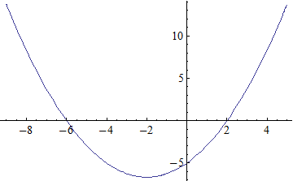
Example 2
Find all three forms for the function described by the parabolic graph.

Slide 5
Example 3
Consider a ball which is thrown upward from a bridge and is allowed to fall past the bridge all the way to the ground. Let$h\left(t\right)=−16t^{2}+48t+160$ be the height of the ball in feet above the ground $t$ seconds after being released.
How high is the ball when it is released? How high is the bridge?
When does the ball hit the ground?
What is the highest height of the ball? When does the ball reach its highest point?
Sketch a graph of the function $h$, showing the domain and range.
What is the average speed over each 1 second time interval? What does this tell us?

Slide 6
Example 4 (3.1 #35)
Year | 1992 | 1993 | 1994 | 1995 | 1996
Percentage | 8 | 14 | 21 | 29.1 | 29.3
The percentage of schools with interactive videodisc players each year from 1992 to 1996 is shown in the table.
Find a quadratic function that best fits this data.
What does this model predict for 1997? 2004?
How good is this model at predicting the future?

