Slide 1
Math 170 Functions, Data, and Models
11 Concavity
Section 2.5

Slide 2
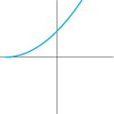
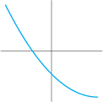
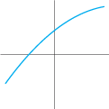
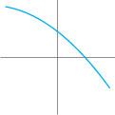
Basic Concepts
If f is a function whose rate of change is constant, then the graph of f is a straight line.
If f is a function whose rate of change is increasing, then the graph of f is concave up (bends upward).
If f is a function whose rate of change is decreasing, then the graph of f is concave down (bends downward).

Slide 3
Formula Examples
Graph the following functions (WolframAlpha) and describe them in terms of concavity:
$f\left(x\right)=−1+3x$
$g\left(y\right)=y^{2}−1$
$h\left(t\right)=\sqrt{t−2}$

Slide 4
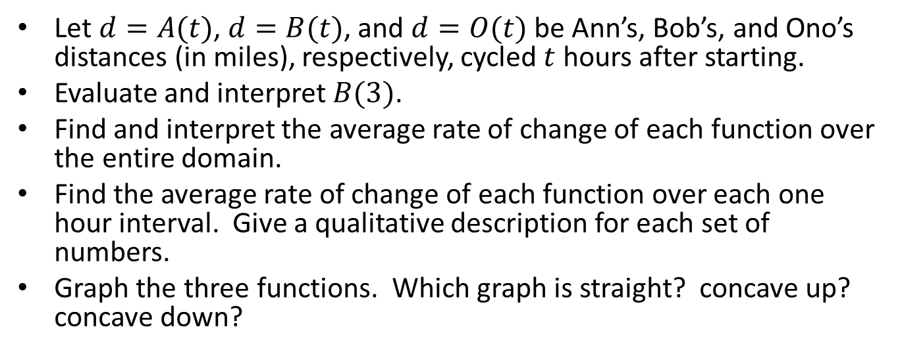
Cycling Example
time (hours) | 0 | 1 | 2 | 3 | 4
Ann’s distance (miles) | 0 | 22 | 44 | 66 | 88
Bob’s distance (miles) | 0 | 16 | 35 | 58 | 85
Ono’s distance (miles) | 0 | 30 | 52 | 72 | 91
Let $d=A(t)$, $d=B(t)$, and $d=O(t)$ be Ann’s, Bob’s, and Ono’s distances (in miles), respectively, cycled $t$ hours after starting.
Evaluate and interpret $B(3)$.
Find and interpret the average rate of change of each function over the entire domain.
Find the average rate of change of each function over each one hour interval. Give a qualitative description for each set of numbers.
Graph the three functions. Which graph is straight? concave up? concave down?

Slide 5
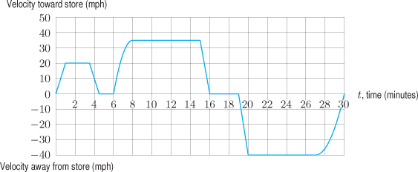
Graph Example
A man drives from his home to a store and back. The entire trip takes 30 minutes. The graph gives his velocity $v(t)$ (in mph) as a function of the time $t$ (in minutes) since he left home. A negative velocity indicates that he is traveling away from the store back to his home.
Where is $v$ increasing? decreasing? constant?
Where is the rate of change of $v$ increasing? decreasing? constant?

Slide 6
Word Examples
Sketch and describe the graphs of the following functions:
US population as a function of time in recent years. ‘U.S. population’
The amount of carbon dioxide in the Earth’s atmosphere as a function of time over the last 200 years. ’global carbon dioxide concentration’
The amount of drug in a person’s body as a function of time since an injection.

