Slide 1
Math 170 Functions, Data, and Models
09 Piecewise-Defined Functions Section 2.3
Comments on Lab 02.

Slide 2
Basic Concept
A function can be defined piecewise.

Slide 3
Tax Example
The U.S. Income Tax rates for the first three tax brackets are
10% on taxable income from $0 to $8,700,
15% on taxable income over $8,700 to $35,350
25% on taxable income over $35,350 to $85,650
Find the income tax paid on taxable incomes of $1,000, $10,000, and $50,000.
Draw a graph of income tax paid as a function of taxable income.
Find a formula for income tax paid as a function of taxable income.
How can it be that 47% of adult pay no federal income tax?

Slide 4
Paint Example
Consider $n=f(A)$, where $n$ is the number of gallon cans of paint to be bought to cover a surface of $A$ square meters. Suppose 1 gallon of paint covers 9 square meters.
What is $f(7)$, $f(18)$, and $f\left(21\right)?$
Draw a graph of $f$ on the domain $\{x :0≤x≤30\}$.
Find a formula for $f$ on the domain $\{x :0≤x≤30\}$.

Slide 5
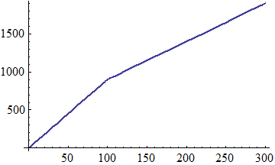
Graph Example
Find a formula for the given graph.

