Slide 1
Math 170 Functions, Data, and Models
08 Section 2.2
Domain & Range
Questions on Lab 02?

Slide 2
Basic Concepts
A function can be represented with a formula, a table, words, or a graph.
For a particular input, find the (only possible) output of a function.
For a particular output of a function, find the possible inputs.
Input ↔ Domain ↔ Independent Variable ↔ Horizontal Axis ↔ Top Row
Output ↔ Range ↔ Dependent Variable ↔ Vertical Axis ↔ Bottom Row

Slide 3
Table Example
Year, t (since 1975) | 0 | 5 | 10 | 15 | 20 | 25 | 30
Revenue, R (million $) | 201 | 364 | 651 | 1075 | 1159 | 2200 | 2200
The table shows the revenue, $R=f(t)$, received, by the National Football League, NFL, from network TV as a function of the year, $t$, since 1975.
What is the domain and range of $R$?

Slide 4
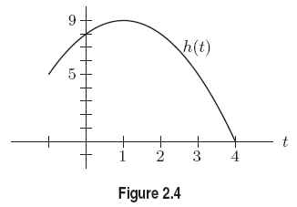
Graph Example
What is the domain and range of the function represented in the graph?

Slide 5
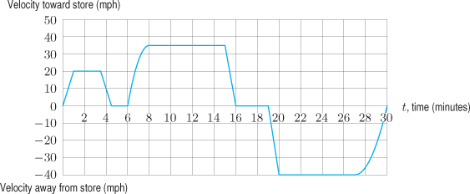
Graph Example
A man drives from his home to a store and back. The entire trip takes 30 minutes. The graph gives his velocity $v(t)$ (in mph) as a function of the time $t$ (in minutes) since he left home. A negative velocity indicates that he is traveling away from the store back to his home.
What is the domain and range of the function $v$?

Slide 6
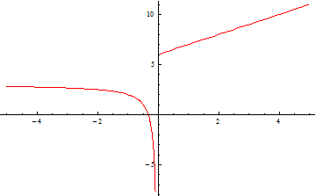
Graph Example
What is the domain and range of the function represented in the graph?

Slide 7
Word Examples
Consider $c=p(w)$, where $c$ is the cost for first-class postage when sending a letter that is $w$ ounces. What is the domain and range of $p$?
Consider $n=f(A)$, where $n$ is the number of gallon cans of paint to be bought to cover a surface of $A$ square meters. What is the domain and range of $f$?
Consider $a=g(A)$, where $a$ is the number of gallons of paint necessary to cover a surface of $A$ square meters. What is the domain and range of $g$?

Slide 8
Word Example
A pot of boiling water is removed from the stove. The temperature of the water, in degrees Fahrenheit, is a function of time, t, in minutes since being taken off the stove. An experiment uses the function until the water temperature falls close to room temperature. What is a reasonable domain and a reasonable range for this experiment?

